Slide 1
SR-71 Control Design
Victoria Nagorski

Slide 2
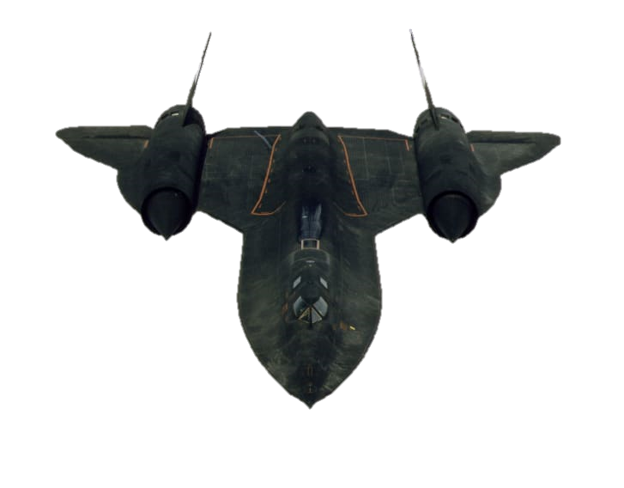
Overview
Problem Statement
Open-Loop Characteristics
Design Requirements
Methodology
SDR
PI – SDR
NZSP
PI – NZSP
PIF – NZSP – CRW
Closing Comments

Slide 3
Project Statement

Slide 4
Problem Statement
The model based on Kelly Johnson’s legendary Blackbird- the SR-71
Determine natural flight characteristics, and then produce desired characteristics through direct digital design

Slide 5
Problem Statement
MIMO System
5 States and 2 Controls
Latitude dynamics chosen by recommendation of Dr V
Easier and more interesting to work with

Slide 6
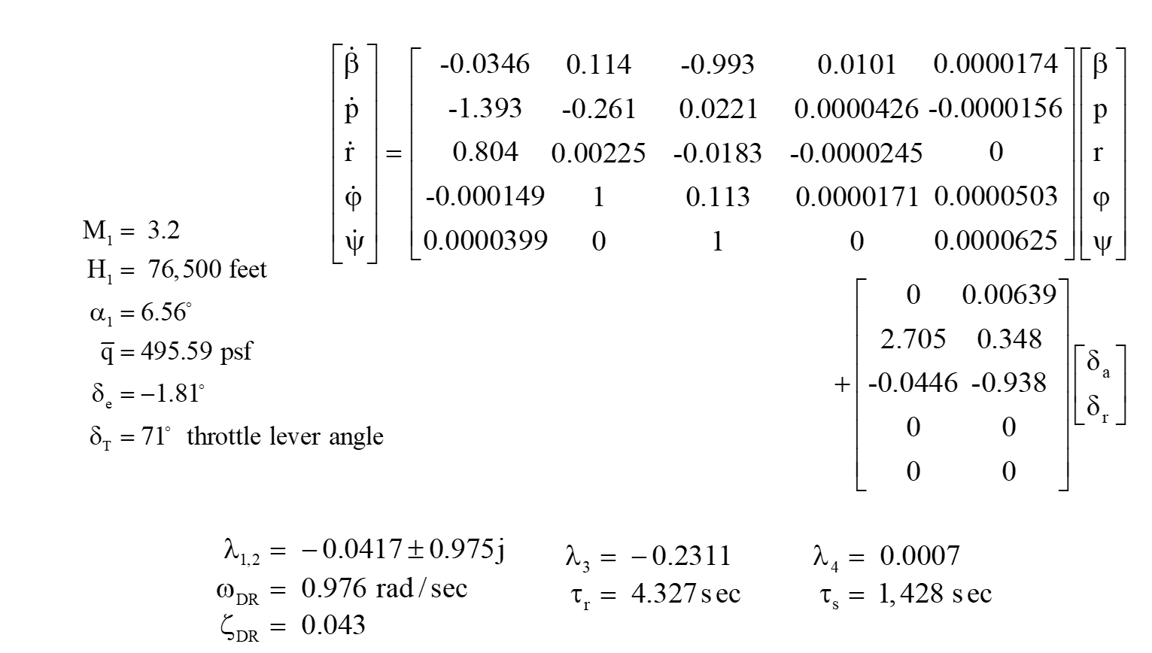
Lateral Model SR-71

Slide 7
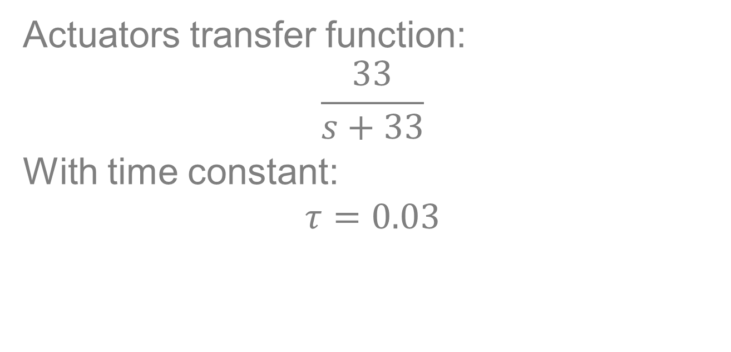
Original Actuators
Actuators transfer function:
$$\frac{33}{s+33}$$
With time constant:
$$τ=0.03$$

Slide 8
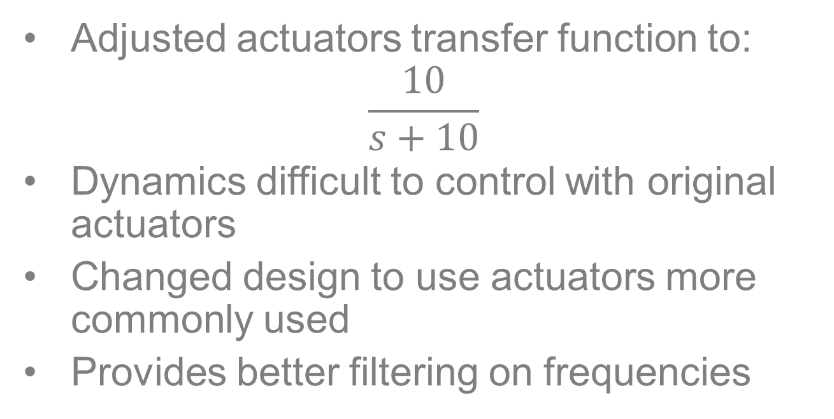
Adjusting Actuators
Adjusted actuators transfer function to:
$$\frac{10}{s+10}$$
Dynamics difficult to control with original actuators
Changed design to use actuators more commonly used
Provides better filtering on frequencies

Slide 9
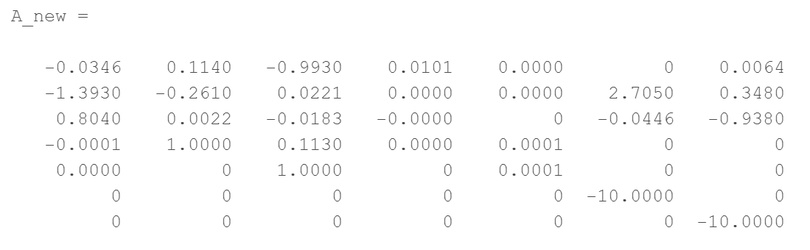
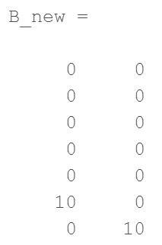
Adding Actuators System

Slide 10
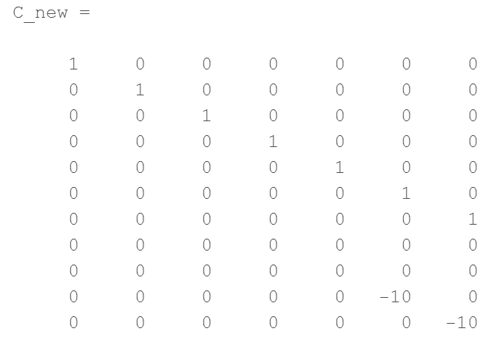
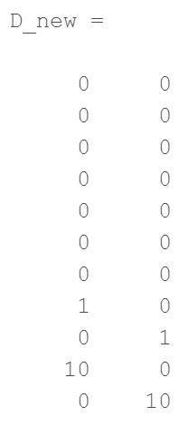
Adding Actuators System

Slide 11
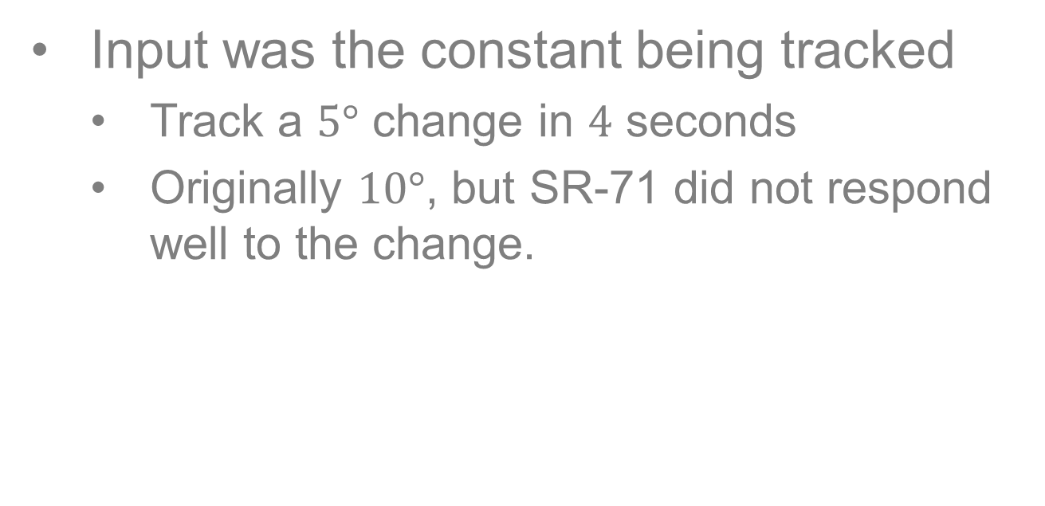
Step Input for NZSP
Input was the constant being tracked
Track a $5°$ change in $4$ seconds
Originally $10°$, but SR-71 did not respond well to the change.

Slide 12
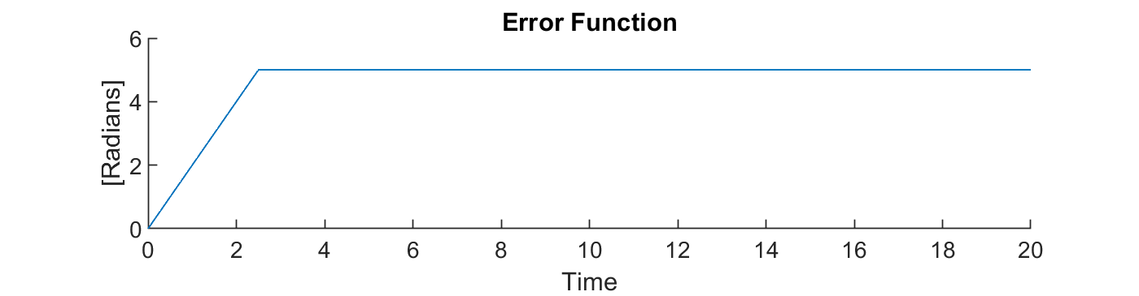
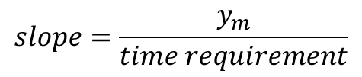
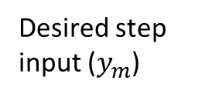
Step Input for NZSP
Building step function for error
Ramp exits in beginning to show natural adjustment to the step function
Desired step input ($y_{m}$)
$$slope=\frac{y_{m}}{time requirement}$$

Slide 13
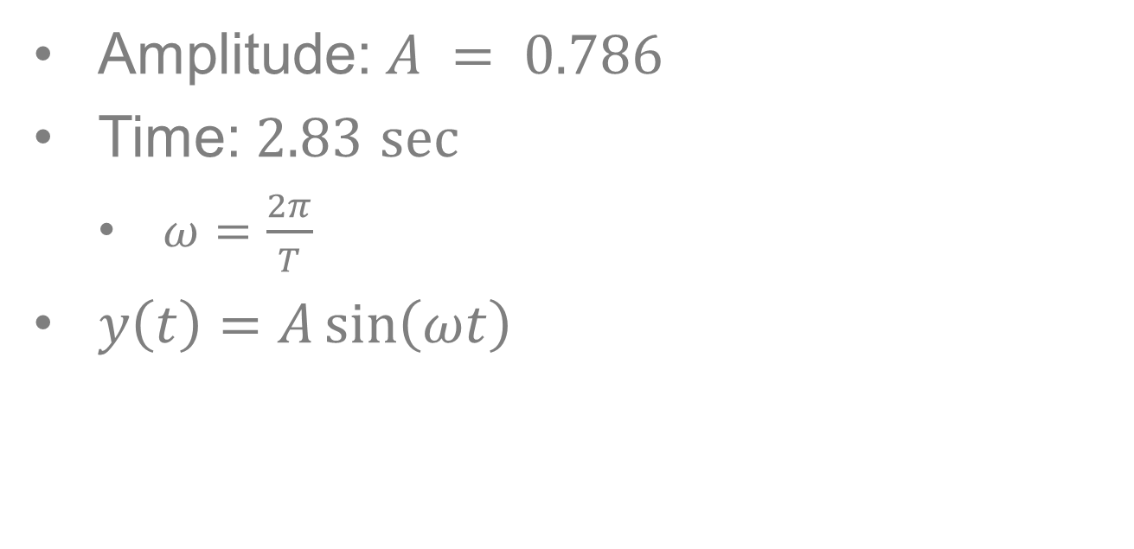
Initial Sinusoidal Input
Amplitude: $A = 0.786$
Time: $2.83$ $sec⁡$
$ω=\frac{2π}{T}$
$y\left(t\right)=A\sin\left(ωt\right)$

Slide 14
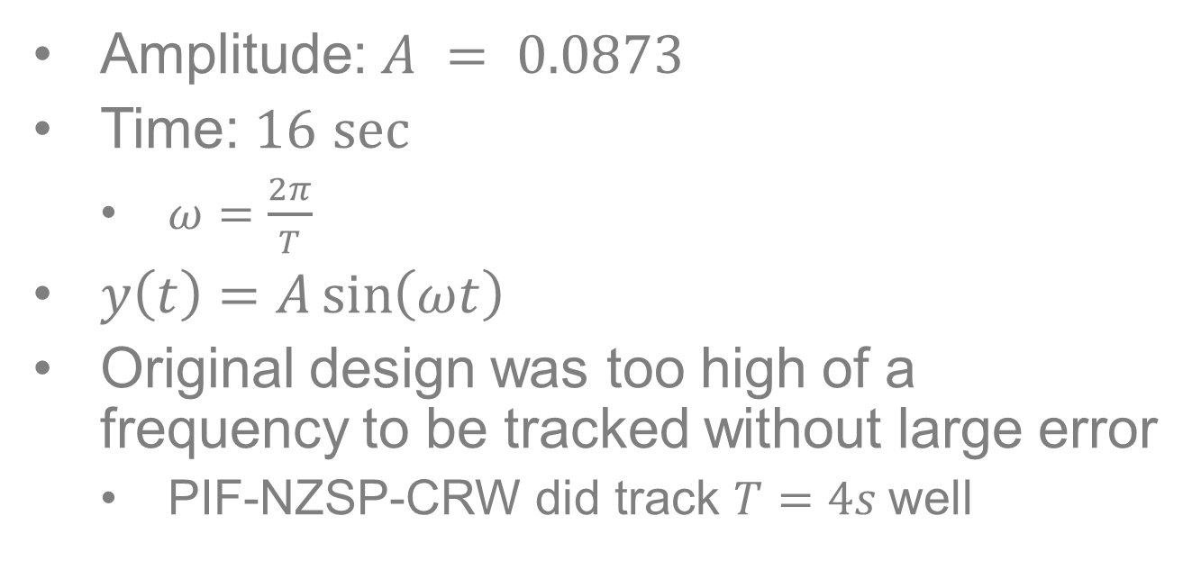
Adjusted Sinusoidal Input
Amplitude: $A = 0.0873$
Time: $16$ $sec⁡$
$ω=\frac{2π}{T}$
$y\left(t\right)=A\sin\left(ωt\right)$
Original design was too high of a frequency to be tracked without large error
PIF-NZSP-CRW did track $T=4s$well

Slide 15
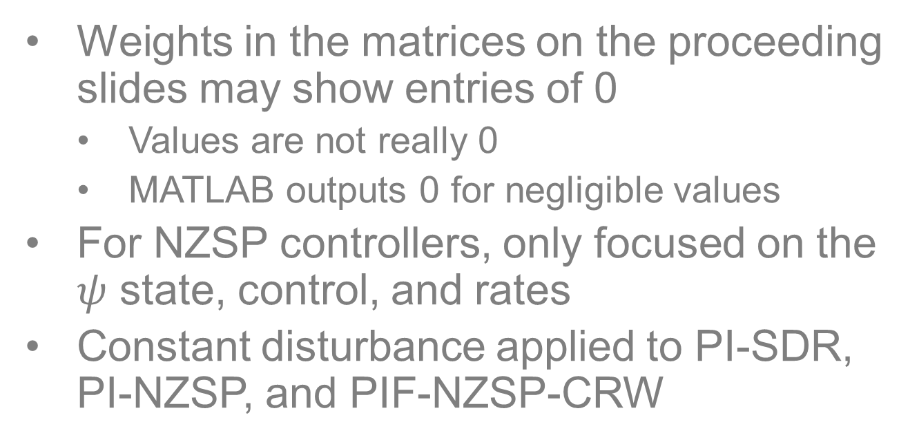
Notes
Weights in the matrices on the proceeding slides may show entries of 0
Values are not really 0
MATLAB outputs 0 for negligible values
For NZSP controllers, only focused on the $ψ$ state, control, and rates
Constant disturbance applied to PI-SDR, PI-NZSP, and PIF-NZSP-CRW

Slide 16
Open-Loop Flight Characteristics

Slide 17
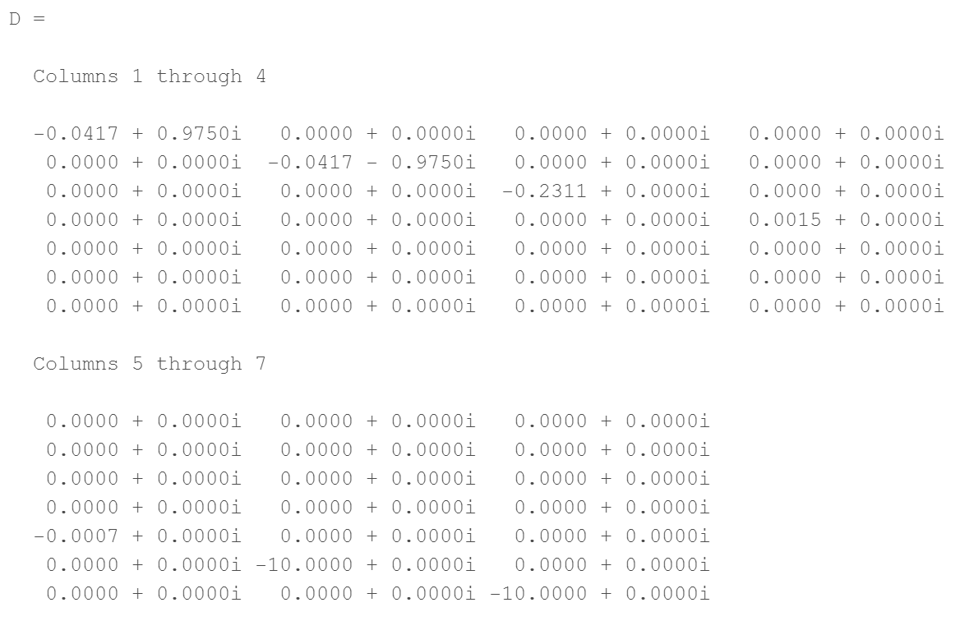
Open Loop Characteristics
Eigenvalues (w/Actuators)
One eigenvalue is unstable- not a stable system.

Slide 18
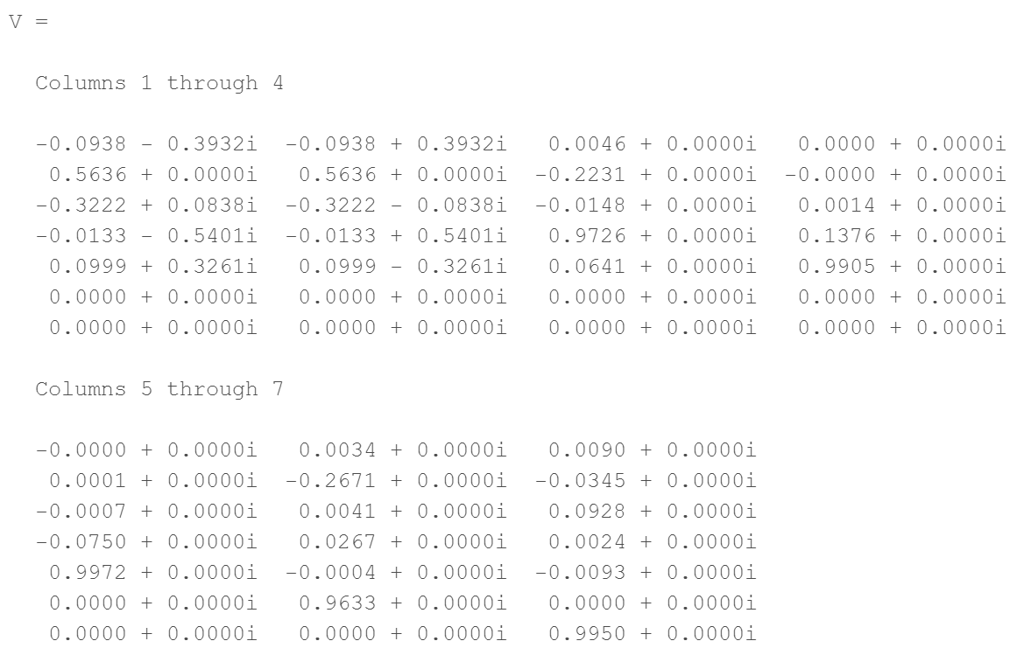
Open Loop Characteristics
Eigenvectors (w/Actuators)

Slide 19
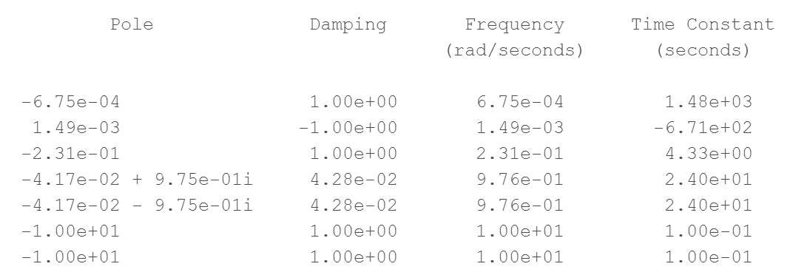
Open-Loop Characteristics
Damping Rations, Frequencies, and Rise Time Constants (w/Actuators)

Slide 20
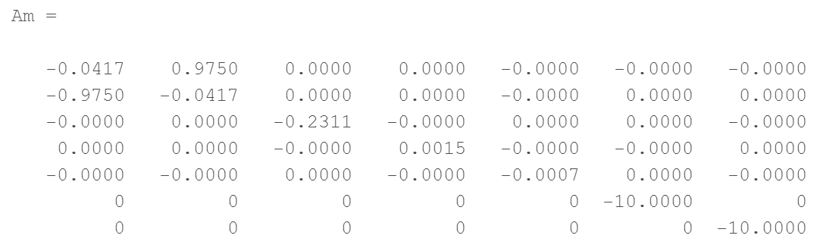
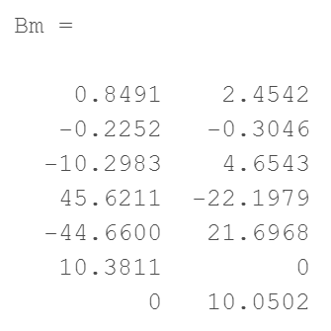
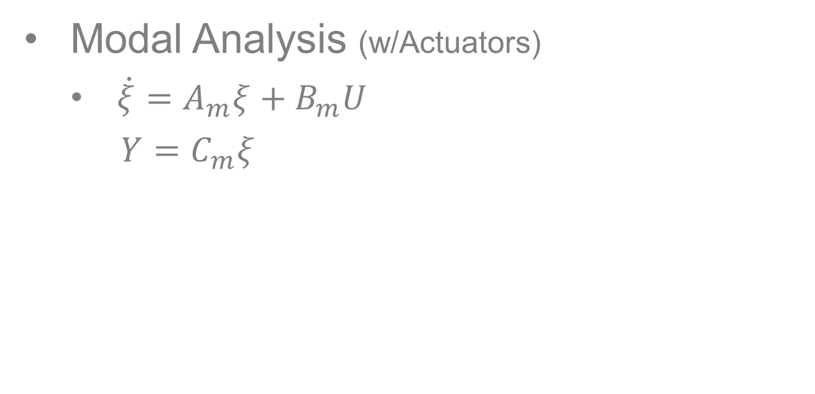
Open-Loop Characteristics
Modal Analysis (w/Actuators)
$\dot{ξ}=A_{m}ξ+B_{m}U$
$Y=C_{m}ξ$

Slide 21
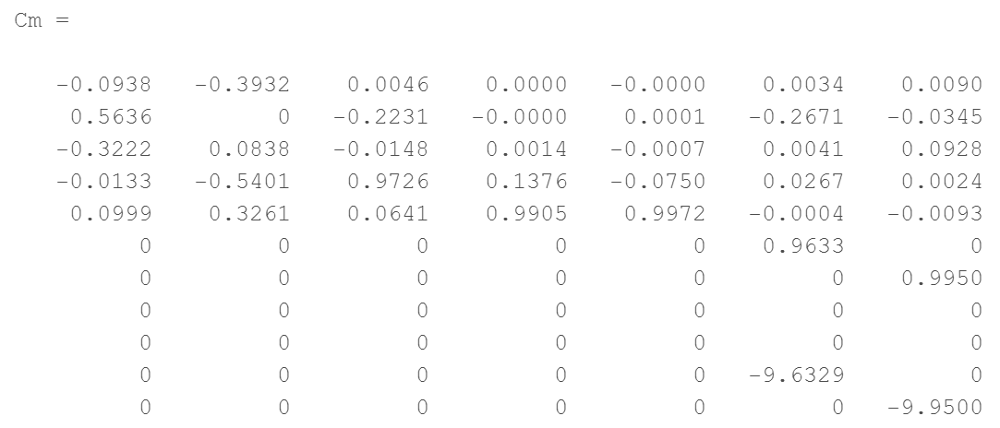
Open-Loop Characteristics
Modal Analysis (w/Actuators)
$\dot{ξ}=A_{m}ξ+B_{m}U$
$Y=C_{m}ξ$

Slide 22
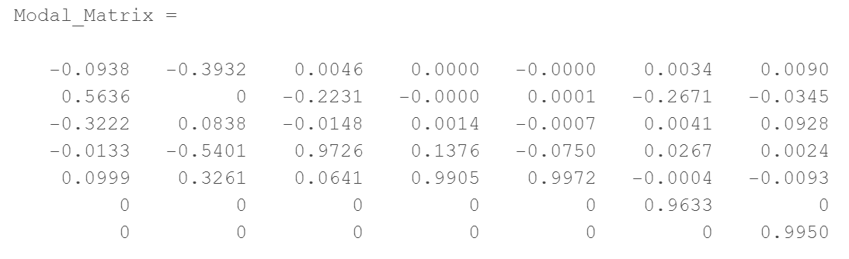
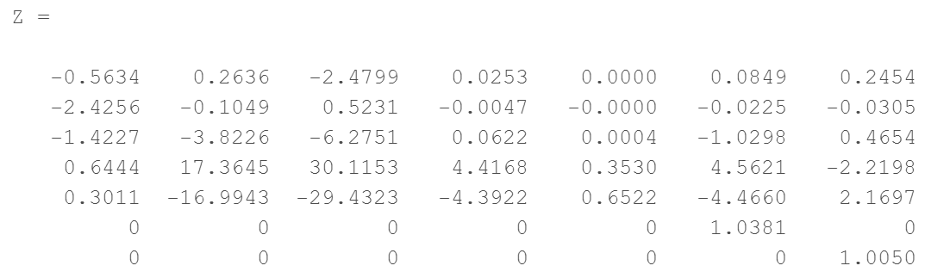
Open-Loop Characteristics
Modal Analysis (w/Actuators)

Slide 23
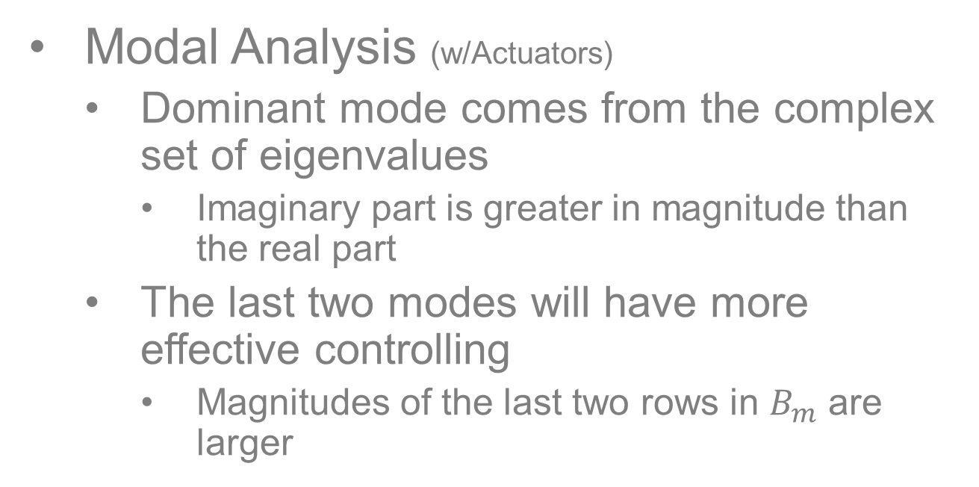
Open-Loop Characteristics
Modal Analysis (w/Actuators)
Dominant mode comes from the complex set of eigenvalues
Imaginary part is greater in magnitude than the real part
The last two modes will have more effective controlling
Magnitudes of the last two rows in $B_{m}$ are larger

Slide 24
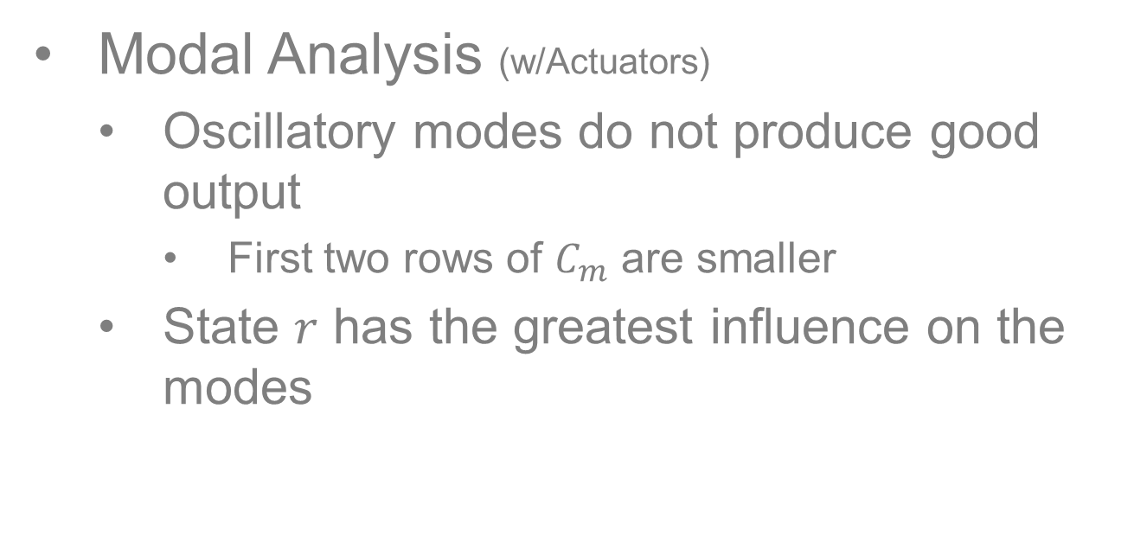
Open-Loop Characteristics
Modal Analysis (w/Actuators)
Oscillatory modes do not produce good output
First two rows of $C_{m}$ are smaller
State $r$ has the greatest influence on the modes

Slide 25
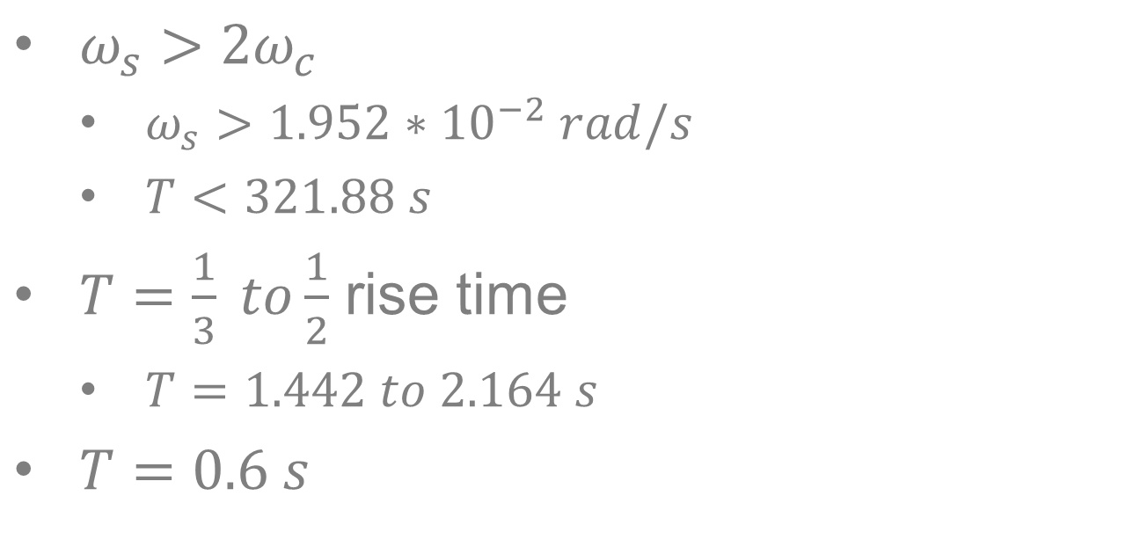
Selection of Sample Period
$ω_{s}>2ω_{c}$
$ω_{s}>1.952∗{10}^{−2} rad/s$
$T<321.88 s$
$T=\frac{1}{3} to\frac{1}{2}$ rise time
$T=1.442 to 2.164 s$
$T=0.6 s$
Had unstable dynamics with anything greater

Slide 26
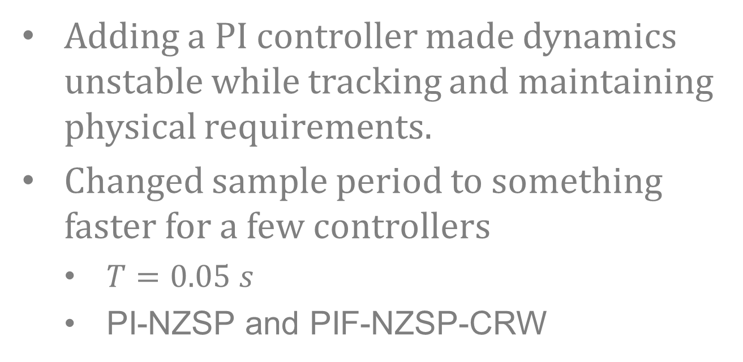
Selection of Sample Period
Adding a PI controller made dynamics unstable while tracking and maintaining physical requirements.
Changed sample period to something faster for a few controllers
$T=0.05 s$
PI-NZSP and PIF-NZSP-CRW

Slide 27
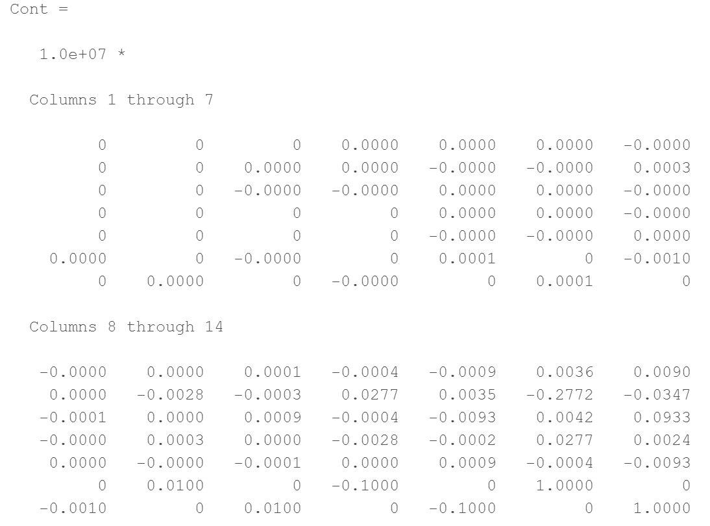
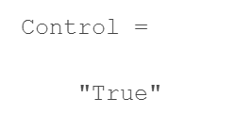
Controllability
System is unstable but controllable.
Notes:
Full row rank

Slide 28
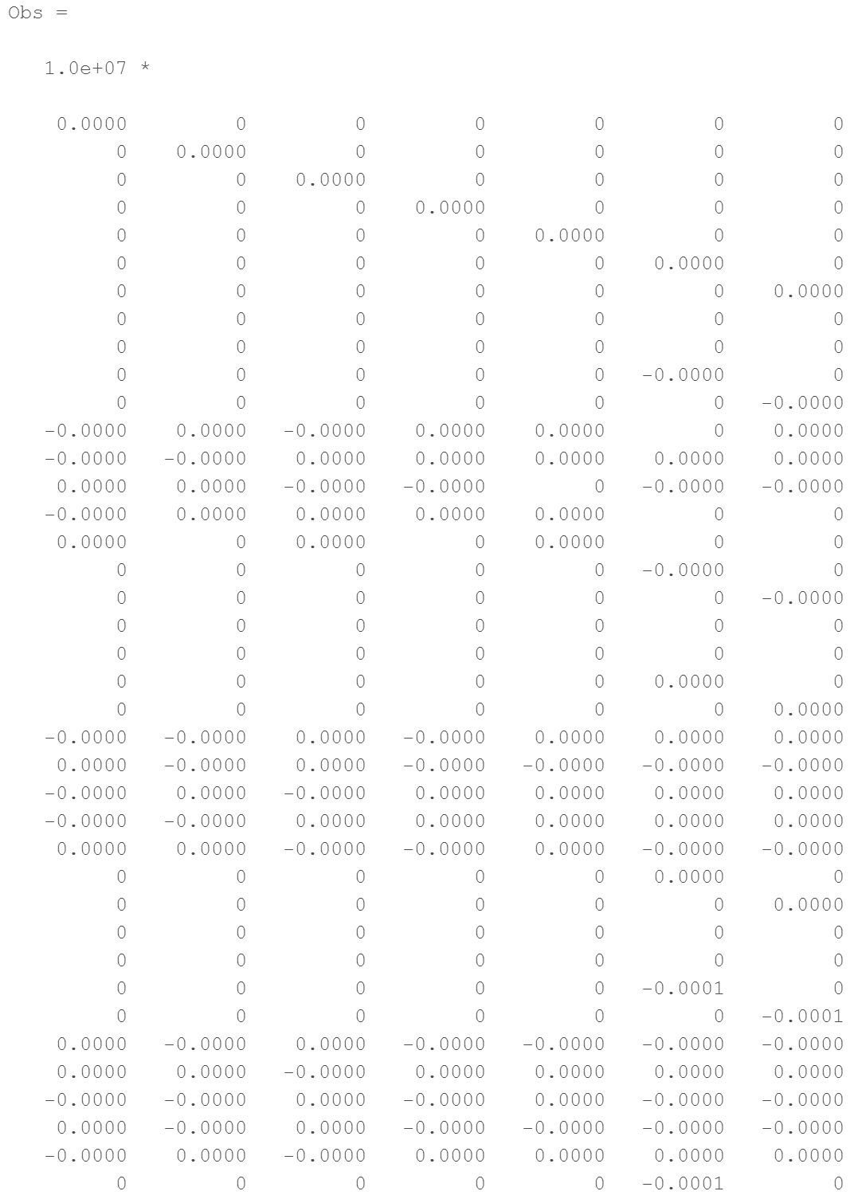
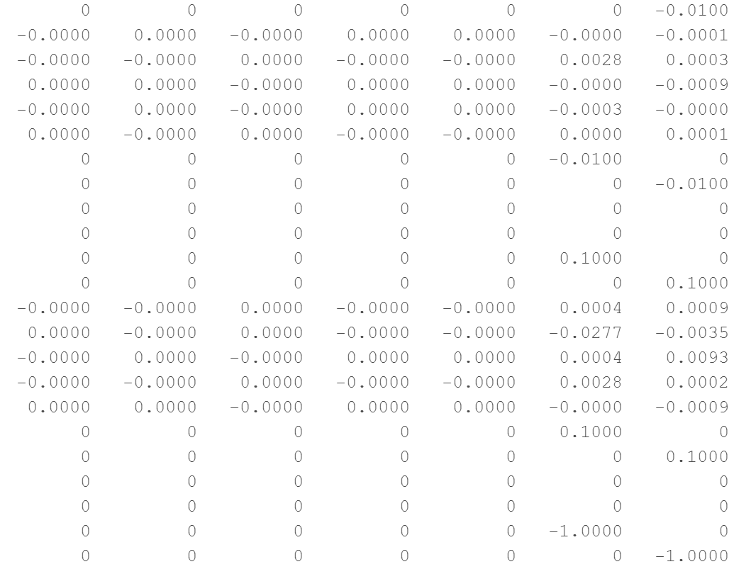
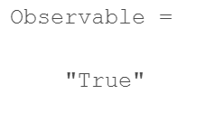
Observability
…
…
System is unstable, but observable and controllable.
Notes:
Full column rank

Slide 29
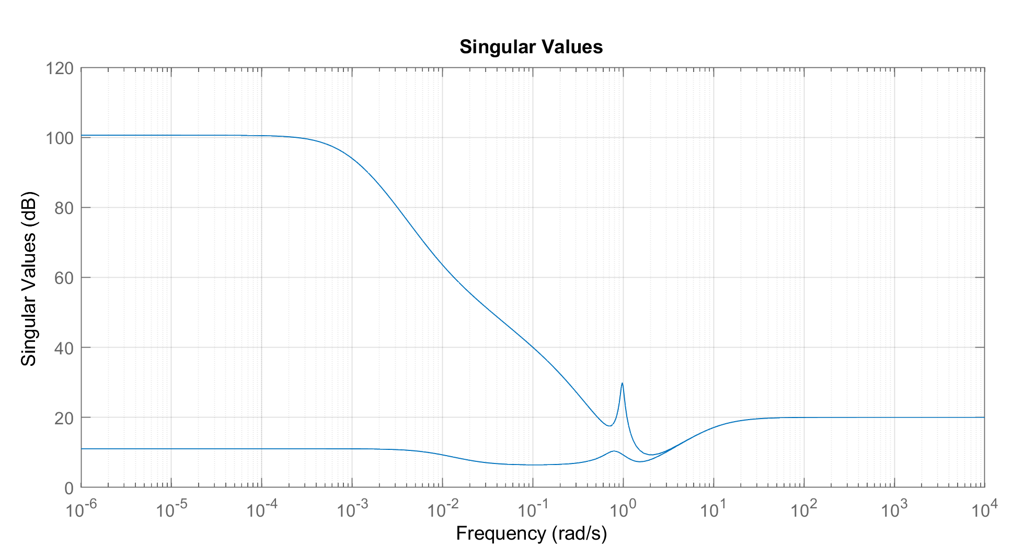
Frequency Domain Analysis
Minimum 20dB gain at 0.1 rad/sec
Maximum crossover frequency of 10 rad/sec
Uncertainty threshold at 20 rad/sec
-20 dB/decade for zero s.s. error
Performance Robustness Requirement
Stability Robustness Requirement

Slide 30
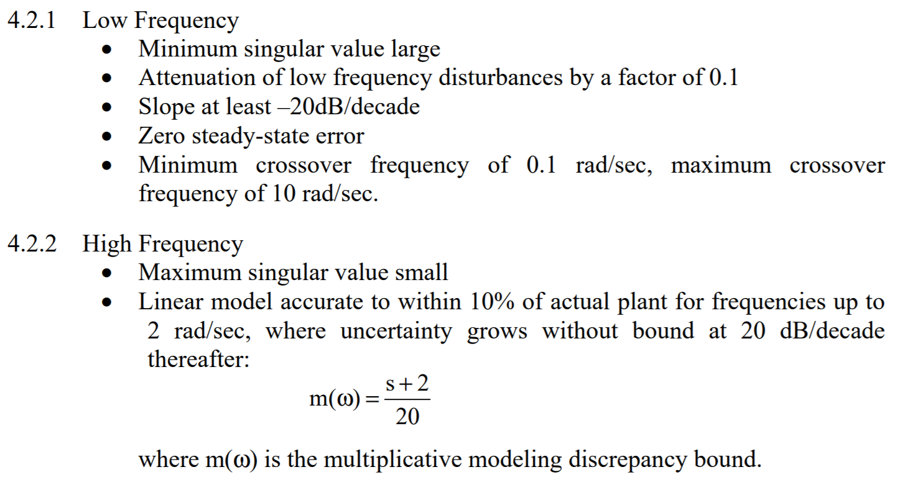
Frequency Domain Analysis
Low Frequency
Top Line
Meets minimum
singular value
Does not meet crossover
requirement
Slope is greater than 20dB/dec
Zero steady-state error not met
Bottom Line
Does not meet any requirements

Slide 31
Frequency Domain Analysis
High Frequency
Requirements are not met
Never crosses over
Singular value flatlines at 20dB

Slide 32
Design Requirements

Slide 33
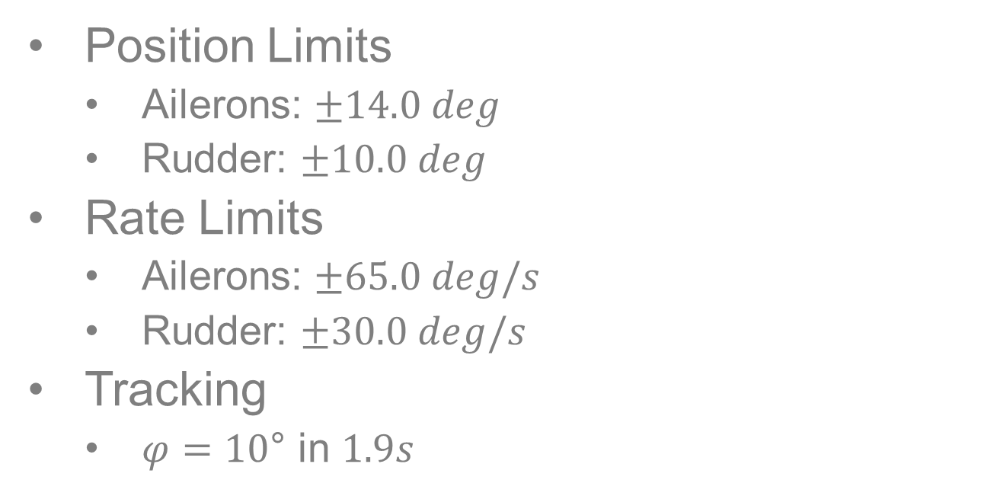
Design Requirements
Position Limits
Ailerons: $±14.0 deg$
Rudder: $±10.0 deg$
Rate Limits
Ailerons: $±65.0 deg/s$
Rudder: $±30.0 deg/s$
Tracking
$φ=10$° in $1.9s$
Hard Requirements – Physically restricted
Soft Requirement
Physical requirements have no flexibility.
Notes:
Using cruising condition Mach = 3.2
Goal: Maintain realistic actuator dynamics while obtaining best disturbance response possible

Slide 34
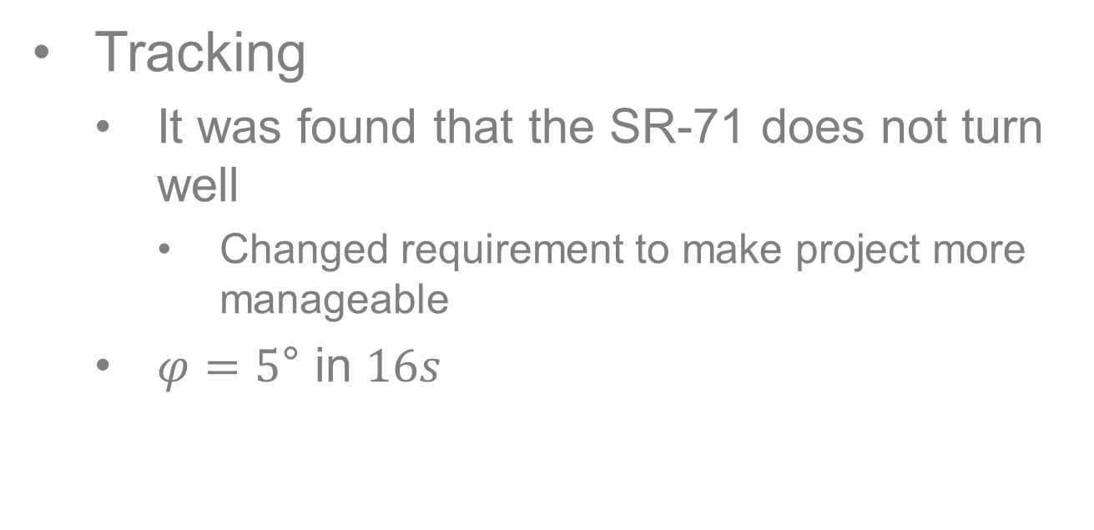
Changes in Requirements
Tracking
It was found that the SR-71 does not turn well
Changed requirement to make project more manageable
$φ=5$° in $16s$
Sometimes requirements need to be adjusted through the design process.
Notes:
Using cruising condition Mach = 3.2
Goal: Maintain realistic actuator dynamics while obtaining best disturbance response possible

Slide 35
Idealistic Design
SDR
Meet physical requirements
Get best response from states as possible
Smooth time histories
Quick response
Quick settle time
Settle to 0
Preferred but not required specifications.
Notes:
Using cruising condition Mach = 3.2
Goal: Maintain realistic actuator dynamics while obtaining best disturbance response possible

Slide 36
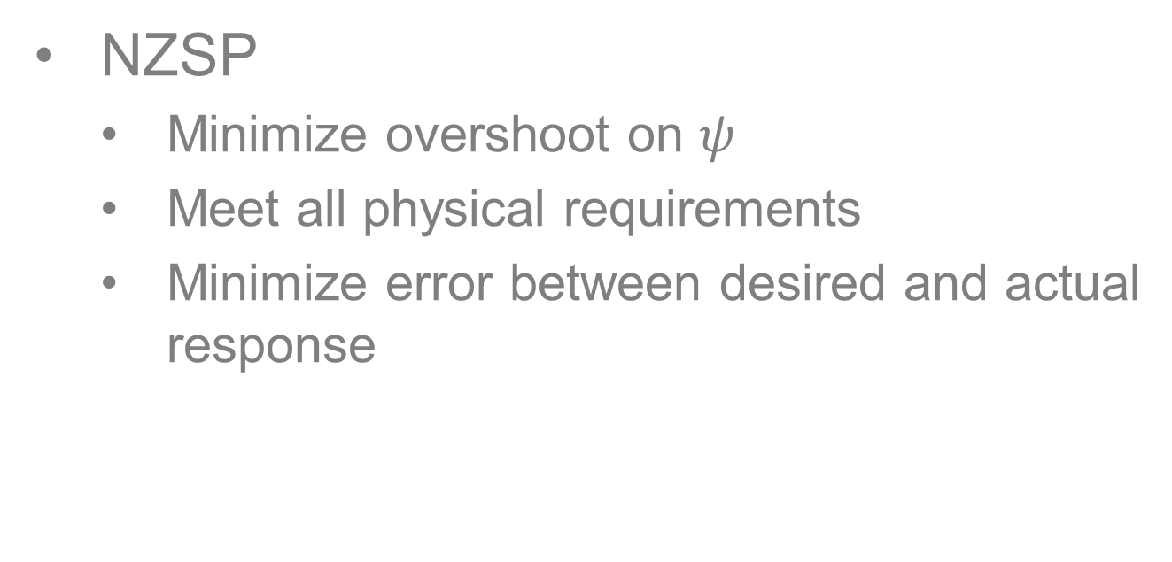
Idealistic Design
NZSP
Minimize overshoot on $ψ$
Meet all physical requirements
Minimize error between desired and actual response
Preferred but not required specifications.
Notes:
Using cruising condition Mach = 3.2
Goal: Maintain realistic actuator dynamics while obtaining best disturbance response possible

Slide 37
Closed-Loop || SDR Design

Slide 38
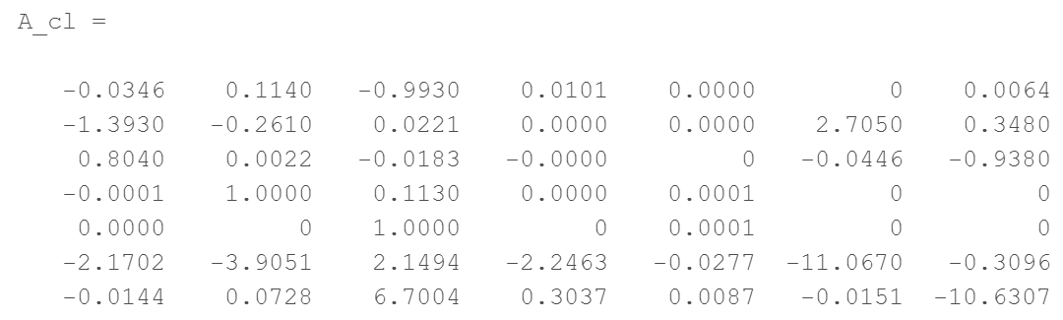
Characteristics
Closed Loop A Matrix

Slide 39
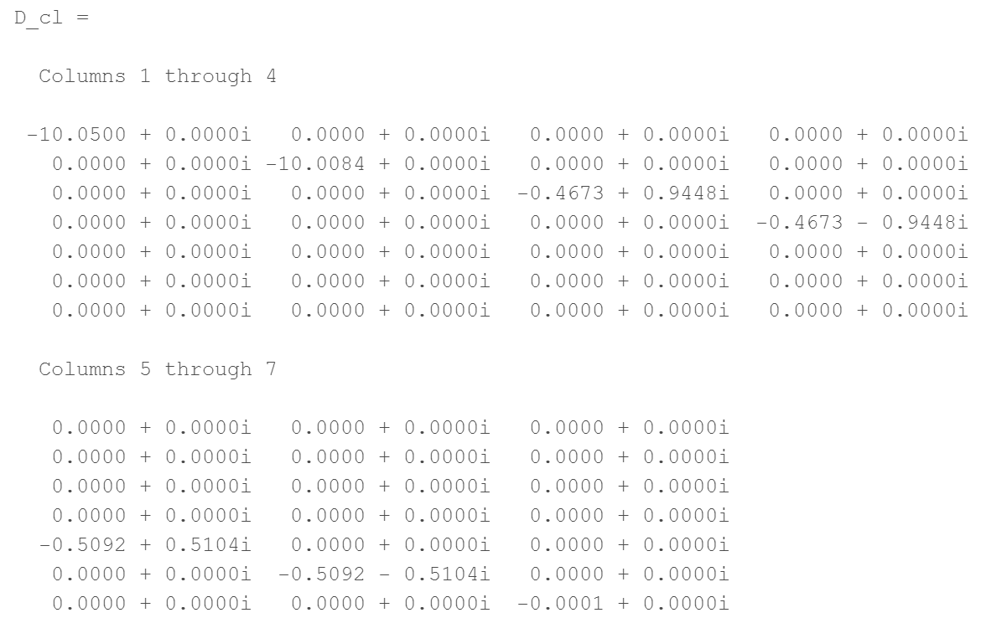
Characteristics
Eigenvalues
All eigenvalues in system are stable.

Slide 40
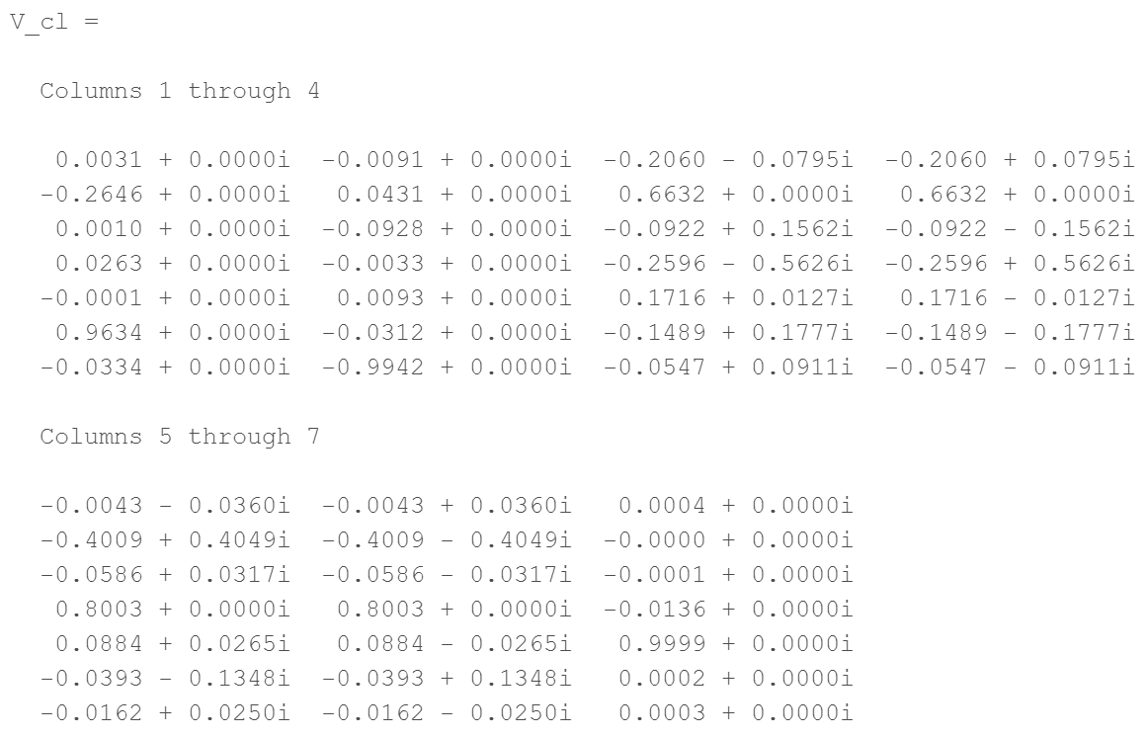
Characteristics
Eigenvectors

Slide 41
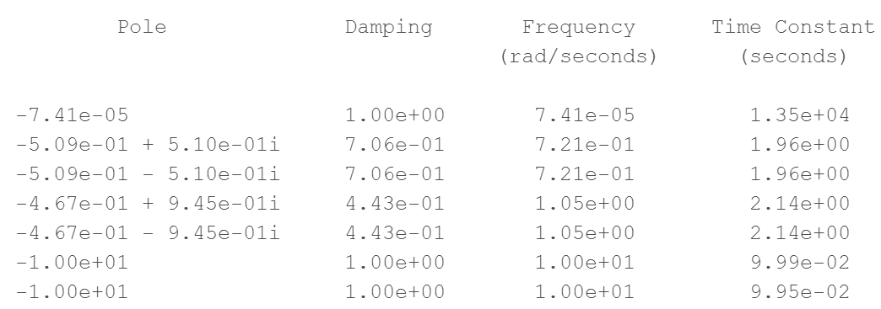
Characteristics
Damping Rations, Frequencies, and Rise Time Constants

Slide 42
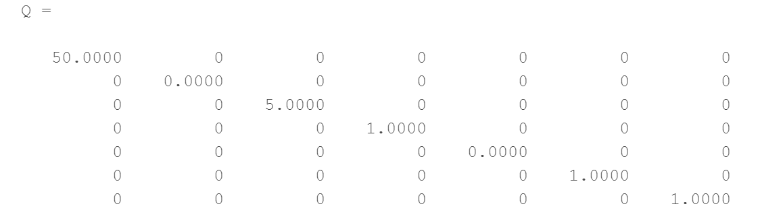
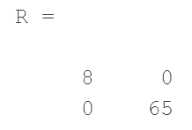
Gains & Weighted Matrices
Chosen Weighted Matrices
Notes:
Not actually 0- but really small. Matlab outputs matrix to look like 0.

Slide 43
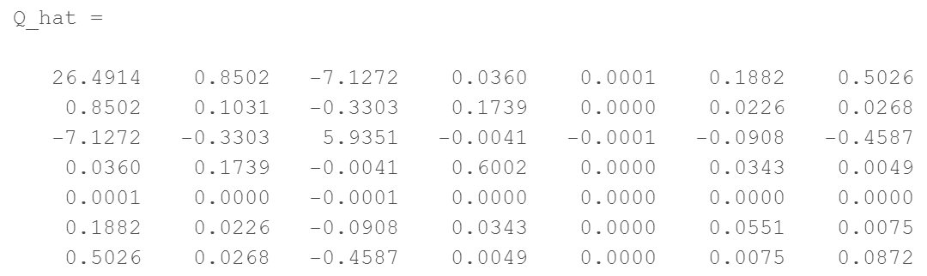
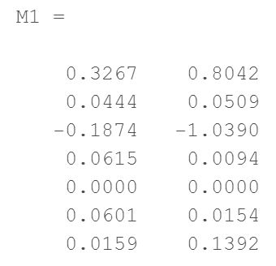
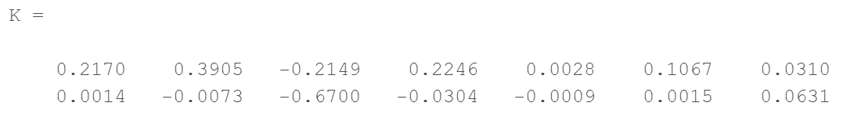
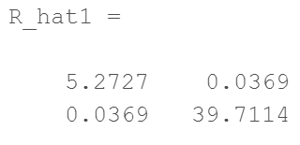
Gains & Weighted Matrices

Slide 44
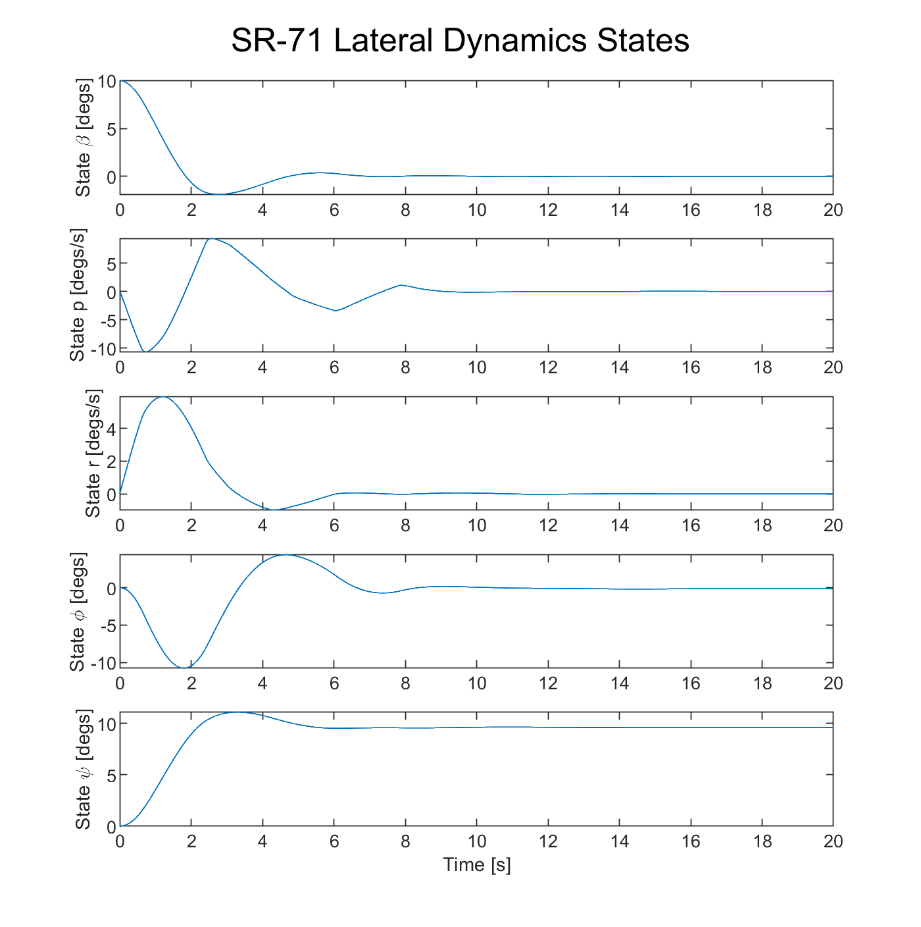
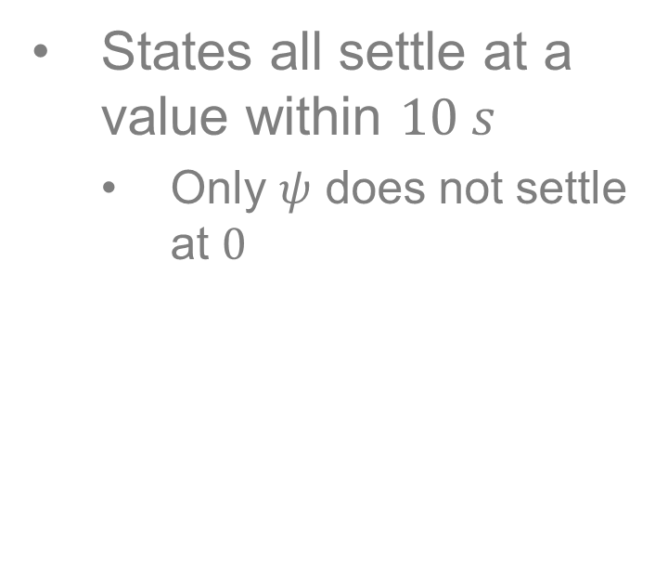
Plots - States
States all settle at a value within $10 s$
Only $ψ$ does not settle at $0$

Slide 45




Plots - Controls
Requirement:
Aileron positions shall stay under $±14.0 degs$
Requirement:
Rudder positions shall stay under $±10.0 degs$

Slide 46

Plots - Commands

Slide 47



Plots - Rates
Requirement:
Aileron rates shall stay under $±65.0 degs/sec$
Requirement:
Rudder rates shall stay under $±30.0 degs/sec$

Slide 48

Frequency Domain Analysis
-20 dB/decade for zero s.s. error
Minimum 20dB gain at 0.1 rad/sec
Performance Robustness Requirement
Maximum crossover frequency of 10 rad/sec
Uncertainty threshold at 20 rad/sec
Stability Robustness Requirement
-20 dB/decade for uncertainty bound

Slide 49
Frequency Domain Analysis
Did not meet requirements for high or low frequencies

Slide 50
Closed-Loop || PI-SDR Design

Slide 51


Set-Up
New State and Control Matrices

Slide 52

Set-Up
Observable: $rank(O) = 8$
Controllable: $rank(C) = 8$
System is observable and controllable.

Slide 53

Characteristics
Closed Loop A Matrix

Slide 54

Characteristics
Eigenvalues
Unstable System

Slide 55

Characteristics
Eigenvectors

Slide 56

Characteristics
Damping Rations, Frequencies, and Rise Time Constants

Slide 57


Gains & Weighted Matrices
Chosen Weighted Matrices

Slide 58




Gains & Weighted Matrices

Slide 59


Plots - States
Overall, state histories became worse with a PI added
$ψ$ does not settle
$φ$ no longer settles at $0$
$β$ does not settle
Settle times are larger
Overall, state histories were worse with PI added.

Slide 60

Plots - Controls
Requirement:
Aileron positions shall stay under $±14.0 degs$
Requirement:
Rudder positions shall stay under $±10.0 degs$

Slide 61

Plots - Commands

Slide 62


Plots - Rates
Requirement:
Aileron rates shall stay under $±65.0 degs/sec$
Requirement:
Rudder rates shall stay under $±30.0 degs/sec$

Slide 63

Frequency Domain Analysis
Minimum 20db gain at 0.1 rad/sec
Maximum crossover frequency of 10 rad/sec
Uncertainty threshold at 20 rad/sec
-20 db/decade for zero s.s. error
Performance Robustness Requirement

Slide 64
Frequency Domain Analysis
Did not meet requirements for high or low frequencies

Slide 65
Closed-Loop || NZSP Design Step Input

Slide 66

Characteristics
Closed Loop A Matrix

Slide 67

Characteristics
Eigenvalues
Stable System

Slide 68

Characteristics
Eigenvectors

Slide 69

Characteristics
Damping Rations, Frequencies, and Rise Time Constants

Slide 70


Gains & Weighted Matrices
Chosen Weighted Matrices
Notes:
Not actually 0- but really small. Matlab outputs matrix to look like 0.

Slide 71




Gains & Weighted Matrices

Slide 72


Characteristics
Steady State Values
Units are in radians.

Slide 73


Plots - States
The state followed the desired state output with minimal error
Could not obtain $0$ overshoot on state $ψ$

Slide 74


Plots - Controls
Requirement:
Aileron positions shall stay under $±14.0 degs$
Requirement:
Rudder positions shall stay under $±10.0 degs$

Slide 75

Plots - Commands

Slide 76



Plots - Rates
Requirement:
Aileron rates shall stay under $±65.0 degs/sec$
Requirement:
Rudder rates shall stay under $±30.0 degs/sec$

Slide 77
Closed-Loop || NZSP Design Sinusoidal Input

Slide 78

Characteristics
Closed Loop A Matrix

Slide 79

Characteristics
Eigenvalues
Stable System

Slide 80

Characteristics
Eigenvectors

Slide 81

Characteristics
Damping Rations, Frequencies, and Rise Time Constants

Slide 82




Gains & Weighted Matrices
Chosen Weighted Matrices

Slide 83


Gains & Weighted Matrices

Slide 84

Plots - States
The state followed the desired state output with minimal error
Experienced a small phase shift between desired and actual state
Realistic to have some sort of lag in a system

Slide 85

Plots - Controls
Requirement:
Aileron positions shall stay under $±14.0 degs$
Requirement:
Rudder positions shall stay under $±10.0 degs$

Slide 86

Plots - Commands

Slide 87

Plots - Rates
Requirement:
Aileron rates shall stay under $±65.0 degs/sec$
Requirement:
Rudder rates shall stay under $±30.0 degs/sec$

Slide 88
Closed-Loop || PI-NZSP Design Step Input

Slide 89


Set-Up
New State and Control Matrices

Slide 90
Set-Up
Observable: $rank(O) = 8$
Controllable: $rank(C) = 8$
System is observable and controllable.

Slide 91

Characteristics
Closed Loop A Matrix

Slide 92

Characteristics
Eigenvalues
Unstable system

Slide 93

Characteristics
Eigenvectors

Slide 94

Characteristics
Damping Rations, Frequencies, and Rise Time Constants

Slide 95


Gains & Weighted Matrices
Chosen Weighted Matrices
Best response came by leaving state weights alone, and weighting controls.

Slide 96




Gains & Weighted Matrices

Slide 97


Characteristics
Steady State Values
Units in radians.

Slide 98


Plots - States
Could not obtain $0$ overshoot on state $ψ$
Large overshoot from desired output
Overall, large error for system

Slide 99

Plots - Controls
Requirement:
Aileron positions shall stay under $±14.0 degs$
Requirement:
Rudder positions shall stay under $±10.0 degs$

Slide 100

Plots - Commands

Slide 101

Plots - Rates
Requirement:
Aileron rates shall stay under $±65.0 degs/sec$
Requirement:
Rudder rates shall stay under $±30.0 degs/sec$

Slide 102
Closed-Loop || PI-NZSP Design Sinusoidal Input

Slide 103


Set-Up
New State and Control Matrices

Slide 104
Set-Up
Observable: $rank(O) = 8$
Controllable: $rank(C) = 8$
System is observable and controllable.

Slide 105

Characteristics
Closed Loop A Matrix

Slide 106

Characteristics
Eigenvalues
Unstable System

Slide 107

Characteristics
Eigenvectors

Slide 108

Characteristics
Damping Rations, Frequencies, and Rise Time Constants

Slide 109


Gains & Weighted Matrices
Chosen Weighted Matrices

Slide 110




Gains & Weighted Matrices

Slide 111

Plots - States
The simulated state followed the desired state output with minimal error
System performed better without PI
Required faster sampling time

Slide 112


Plots - Controls
Requirement:
Aileron positions shall stay under $±14.0 degs$
Requirement:
Rudder positions shall stay under $±10.0 degs$

Slide 113

Plots - Commands

Slide 114

Plots - Rates
Requirement:
Aileron rates shall stay under $±65.0 degs/sec$
Requirement:
Rudder rates shall stay under $±30.0 degs/sec$

Slide 115
Closed-Loop || PIF-NZSP-CRW Design Step Input

Slide 116


Set-Up
New State and Control Matrices

Slide 117

Set-Up
Observable: $rank(O) =10$
Controllable: $rank(C) =10$
System is observable and controllable.

Slide 118

Characteristics
Closed Loop A Matrix

Slide 119


Characteristics
Eigenvalues
Unstable System

Slide 120


Characteristics
Eigenvectors

Slide 121

Characteristics
Damping Rations, Frequencies, and Rise Time Constants

Slide 122


Gains & Weighted Matrices
Chosen Weighted Matrices

Slide 123




Gains & Weighted Matrices

Slide 124


Characteristics
Steady State Values
Units are in radians.

Slide 125


Plots - States
Less error than PI-NZSP
Does not quite settle at correct value
Less overshoot in $ψ$

Slide 126

Plots - Controls
Requirement:
Aileron positions shall stay under $±14.0 degs$
Requirement:
Rudder positions shall stay under $±10.0 degs$

Slide 127

Plots - Commands

Slide 128

Plots - Rates
Requirement:
Aileron rates shall stay under $±65.0 degs/sec$
Requirement:
Rudder rates shall stay under $±30.0 degs/sec$

Slide 129
Closed-Loop || PIF-NZSP-CRW Design Sinusoidal Input

Slide 130


Set-Up
New State and Control Matrices

Slide 131
Set-Up
Observable: $rank(O) =10$
Controllable: $rank(C) =10$
System is observable and controllable.

Slide 132

Characteristics
Closed Loop A Matrix

Slide 133


Characteristics
Eigenvalues
Unstable System

Slide 134


Characteristics
Eigenvectors

Slide 135

Characteristics
Damping Rations, Frequencies, and Rise Time Constants

Slide 136


Gains & Weighted Matrices
Chosen Weighted Matrices

Slide 137




Gains & Weighted Matrices

Slide 138


Characteristics
Steady State Values
Units are in radians.

Slide 139

Plots - States
The simulated state followed the desired state output with minimal error
Comparable to PI at low frequencies
Performs better than PI at higher frequencies
Easier on controls than PI

Slide 140

Plots - Controls
Requirement:
Aileron positions shall stay under $±14.0 degs$
Requirement:
Rudder positions shall stay under $±10.0 degs$

Slide 141

Plots - Commands

Slide 142

Plots - Rates
Requirement:
Aileron rates shall stay under $±65.0 degs/sec$
Requirement:
Rudder rates shall stay under $±30.0 degs/sec$

Slide 143
Closing Comments

Slide 144
Closing Comments
SDR
Hard to get a good disturbance response
Could not bring all states to 0
Was able to meet physical requirements on control surfaces

Slide 145
Closing Comments
PI-SDR
Much harder to meet physical requirements of control surfaces compared to SDR
Easy to saturate R matrix trying to meet physical requirements

Slide 146

Closing Comments
NZSP
Focused on $ψ$ since a tracking problem
Was able to meet physical requirements on control surfaces
Tried to minimize overshoot
Consequently, slowed convergence time
Sinusoidal tracking had visibly reduced amplitude

Slide 147

Closing Comments
PI-NZSP
Much greater overshoot on $ψ$ state
Makes sense since PI controllers are supposed to increase rise time and decrease settling time
Sinusoidal tracking was about the same result as without PI
Was using a faster sampling rate in this design

Slide 148
Closing Comments
PIF-NZSP-CRW
Step track
Much better results in comparison to just PI-NZSP
Preference to the NZSP controller
Sinusoidal track
Preferred method to track sinusoidal waves at higher frequencies
As shown, not a large difference at low frequencies

Slide 149
Next Iteration
Iterate different sampling rates into design
Cut sampling time to be significantly smaller after noticing an inability to control system
See if there is an in-between value that produces acceptable results

Slide 150
Next Iteration
Iterate different frequencies for sinusoid tracking
“Bake in” frequency analysis as controllers are designed
Design more robust controllers
Not reserved for post design analysis

